Slide 1
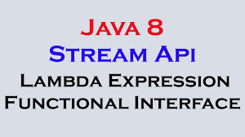

Slide 2
Java 8 got released on March 18, 2014.
Lambda Expression
Functional interface
Streams API
Method references
Java 8 features:

Slide 3
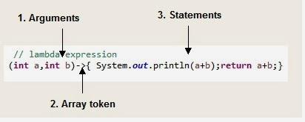
Lambda Expression:
Optional type declaration
Optional parenthesis around parameter
Optional curly braces
Optional return keyword

Slide 4
Advantages of Lambda Expression
Higher Efficiency: By using Stream API and lambda expressions
Fewer Lines of Code
Sequential and Parallel Execution Support by passing behavior in methods

Slide 5
What is Stream:
Sequence of elements
Source
Aggregate operations
Pipelining
Automatic iterations

Slide 6

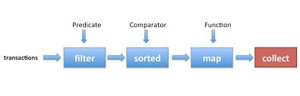



Stream:
s

Slide 7
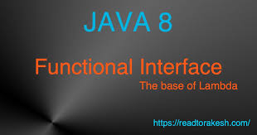
Functional Interface

Slide 8
Functional Interface
The major benefit of java 8 functional interfaces is that we can use lambda expressions to instantiate them .
TO avoid using bulky anonymous class implementation.
Java 8 Collections API has been rewritten and new Stream API is introduced that uses a lot of functional interfaces.

